Slide 1
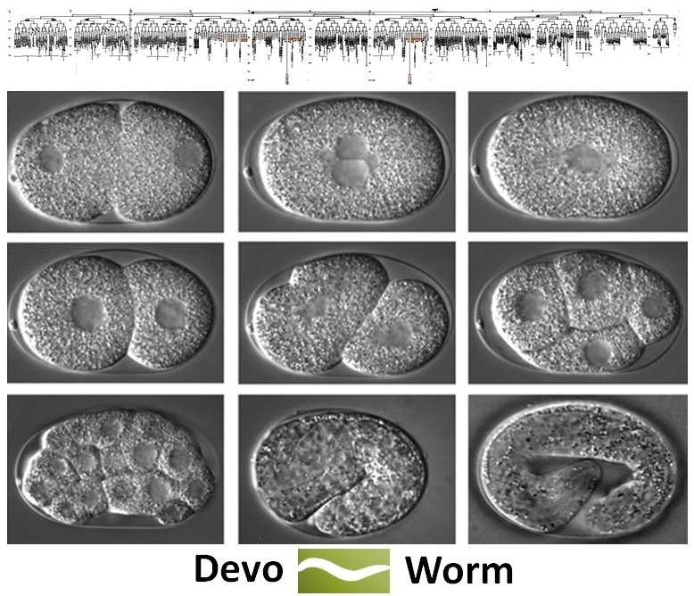
DevoWorm: reconstructing development as bits and datatypes
Bradly Alicea, Steve McGrew, Richard Gordon, Stephen Larson, and Mark Watts

Slide 2
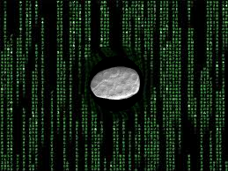
Hacking the Organism, or Hacking the Scientific Interpretation?
DevoWorm is a rare combination:
DEVELOPMENTAL (In silico) HACKING: we want to extend the accomplishments of OpenWorm by focusing on development. Insight through data structures. A model for potential experimental manipulation.

Slide 3

Hacking the Organism, or Hacking the Scientific Interpretation?
DevoWorm is a rare combination:
DEVELOPMENTAL (In silico) HACKING: we want to extend the accomplishments of OpenWorm by focusing on development. Insight through data structures. A model for potential experimental manipulation.
INTERPRETIVE HACKING: we want to better understand the generative process of development. This can be done via theoretical constructs.

Slide 4
Why C. elegans? Unique Properties
Embryogenesis is analytically tractable:
* C. elegans has 959 cells in adult hermaphrodite, 1031 in adult male.
* roughly 850 cells are unique, 50 pairs are equivalent pairs.

Slide 5
Why C. elegans? Unique Properties
Embryogenesis is analytically tractable:
* C. elegans has 959 cells in adult hermaphrodite, 1031 in adult male.
* roughly 850 cells are unique, 50 pairs are equivalent pairs.
C. elegans is eutelic: each adult individual in species has a fixed number of cells.
* each lineage consists of founder cells and descendents.
* cell lineages are invariant across individuals (small differences between males and hermaphrodites).

Slide 6
Why C. elegans? Unique Properties
Embryogenesis is analytically tractable:
* C. elegans has 959 cells in adult hermaphrodite, 1031 in adult male.
* roughly 850 cells are unique, 50 pairs are equivalent pairs.
C. elegans is eutelic: each adult individual in species has a fixed number of cells.
* each lineage consists of founder cells and descendents.
* cell lineages are invariant across individuals (small differences between males and hermaphrodites).
Two other features of C. elegans development are ripe for revisitation:
* development is generative but invariant. How does this happen?
* detailed accounting of developmental symmetry along three axes.

Slide 7
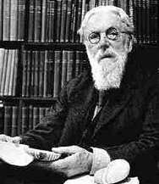
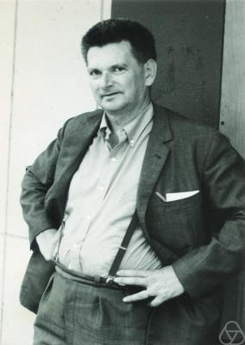
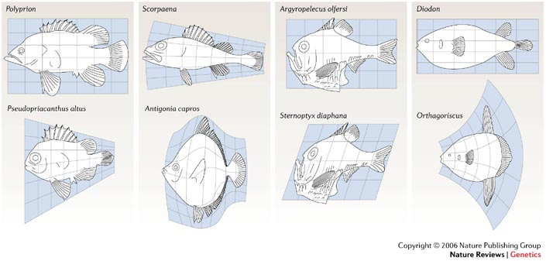
Why Development? From “is” to “how”
Development (and evolution) provides us with indispensible information about the organism:
D’Arcy Thompson (On Growth and Form), Rene Thom (Structural Stability and Morphogenesis): diversity of structure understood as a series of isomorphic mappings.
* historical constraints give rise to structure, in turn give rise to functional diversity and limitations (what is and is not possible).
COURTESY: Nature Reviews Genetics 7, 401-406 (2006)

Slide 8
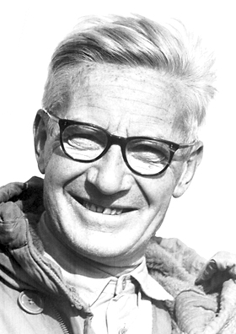
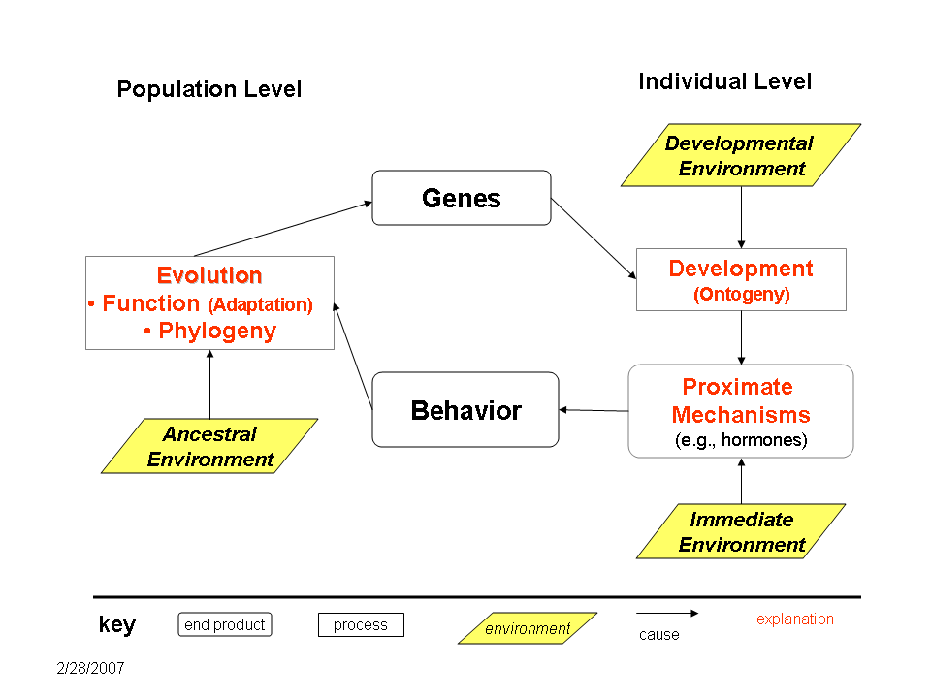
Why Development? From “is” to “how”
Development (and evolution) provides us with indispensible information about the organism:
D’Arcy Thompson (On Growth and Form), Rene Thom (Structural Stability and Morphogenesis): diversity of structure understood as a series of isomorphic mappings.
Niko Tinbergen: one way to understand function is to understand how traits arise in development.
* provides a layer of relational information not immediately apparent from adult morphology and genetics.

Slide 9
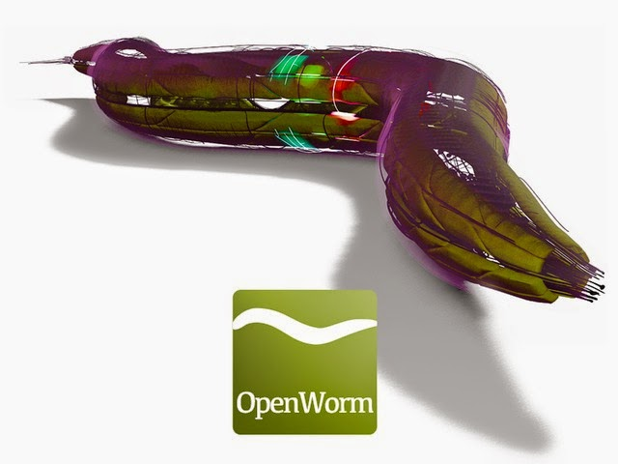
In the beginning, there a vision for whole-organism emulation (and it was good)
OpenWorm provides a basis for understanding the adult C. elegans and its nervous system
Then, there arose a need to re-interpret how development unfolds
Lineage trees (Sulston et.al) are an excellent means to an end, but do not describe the
developmental process (embryogenesis) very well

Slide 10
CyberWorm Slides here

Slide 11
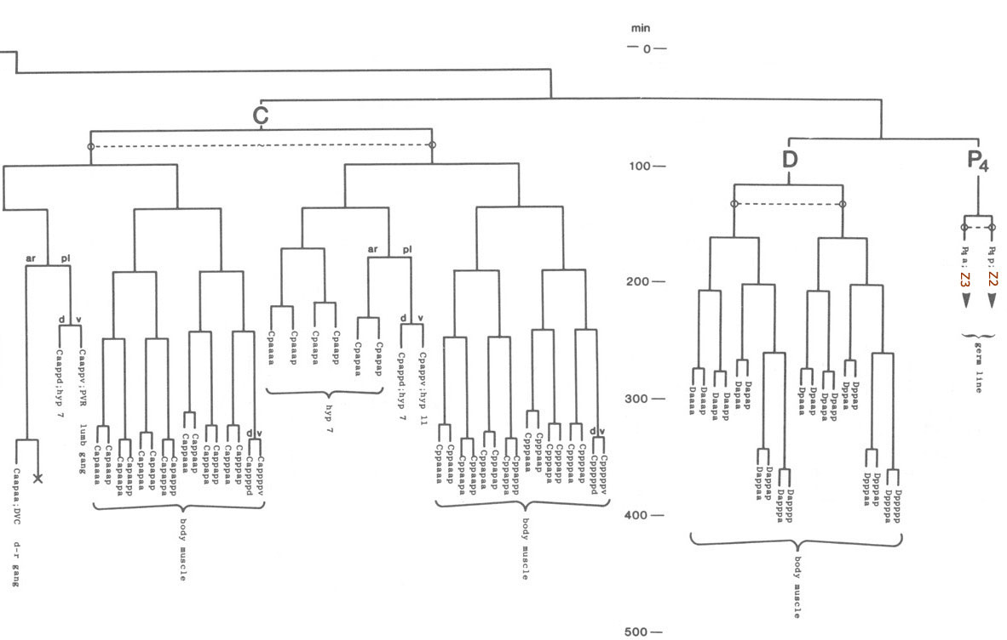
PROBLEM: lineage trees are merely descriptive, provide a “whom begat whom” view of development.
* branching process is actually multi-dimensional (L-R, A-P, D-V).
* each lineage contains cells with variants on the parent (e.g. AB parent, ABlrrpvva descendent).

Slide 12
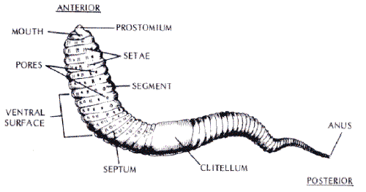
PROBLEM: lineage trees are merely descriptive, provide a “whom begat whom” view of development.
* branching process is actually multi-dimensional (L-R, A-P, D-V).
* lineage trees are organized along only one of these axes (anterior-posterior).

Slide 13
Regulative vs. Mosaic Development
Differentiation trees are based on the presence of expansion and contraction waves triggered by cell state splitter activity in individual cells.
* cell state splitter: filmentous structure that sends a binary signal (change of state information) to the genome.

Slide 14
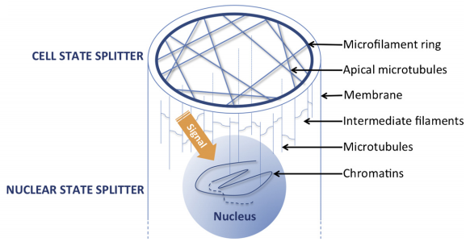
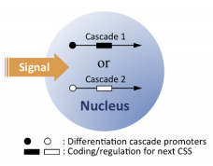
Regulative vs. Mosaic Development
Differentiation trees are based on the presence of expansion and contraction waves triggered by cell state splitter activity in individual cells.
COURTESY: Lu, K., Cao, T., and Gordon, R. A cell state splitter and differentiation wave working-model for embryonic stem cell development and somatic cell epigenetic reprogramming. Biosystems, 109, 390-396 (2012).

Slide 15
Regulative vs. Mosaic Development
Activation of cell state splitters have slightly different types of effects in mosaic embryos (e.g. worms).
* originally based on observations of regulative embryos (e.g. axolotls).

Slide 16
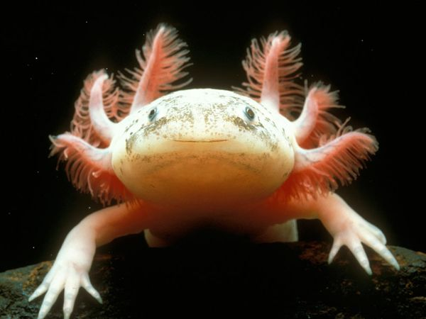
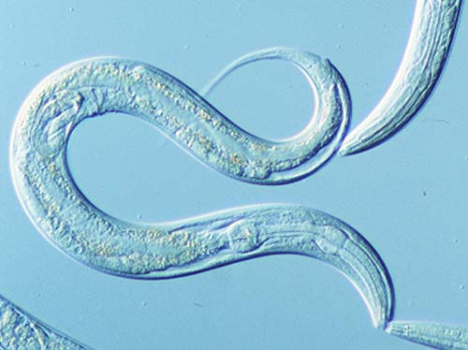
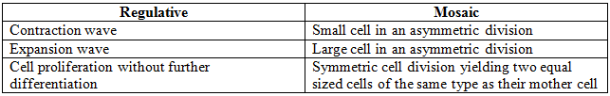
Regulative vs. Mosaic Development
Activation of cell state splitters have slightly different types of effects in mosaic embryos (e.g. worms).
* originally based on observations of regulative embryos (e.g. axolotls).

Slide 17
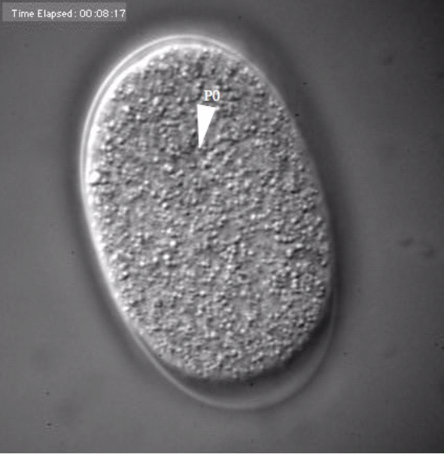
C. Elegans
Embryogenesis (from sphere to worm)
P0 originates from male-female gonadal stage.

Slide 18
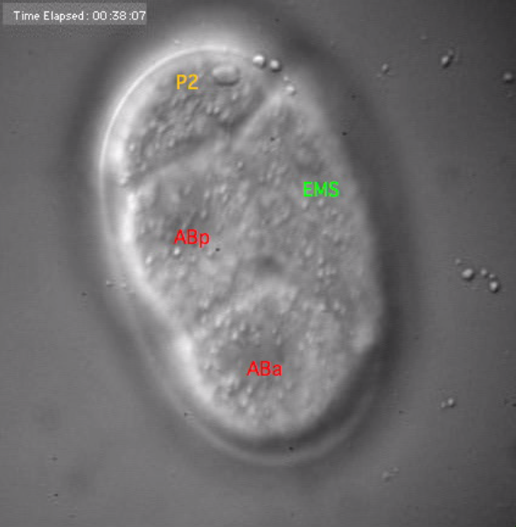
Four founder cells
(two divisions)

Slide 19
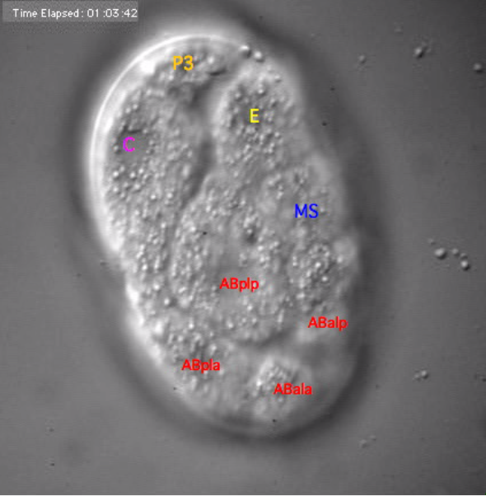


Four cells in AB lineage
(two divisions)

Slide 20
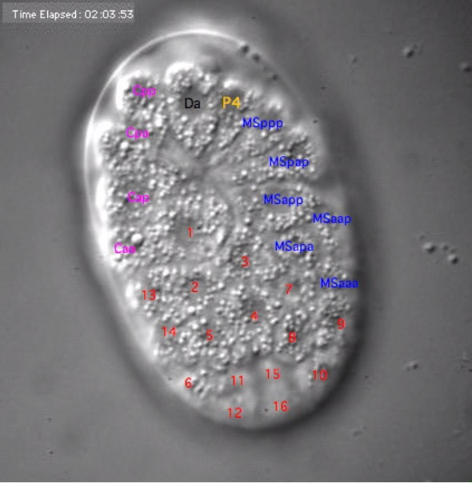

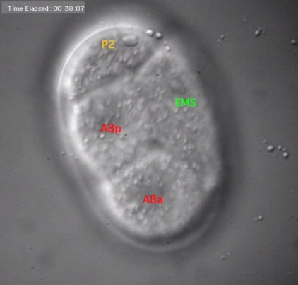
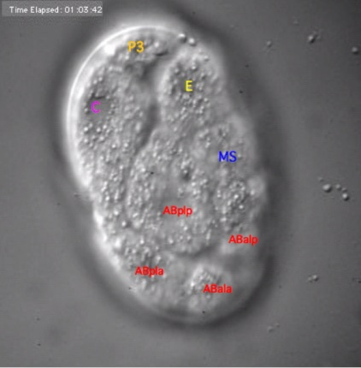
Six cells in MS lineage
(three divisions)

Slide 21

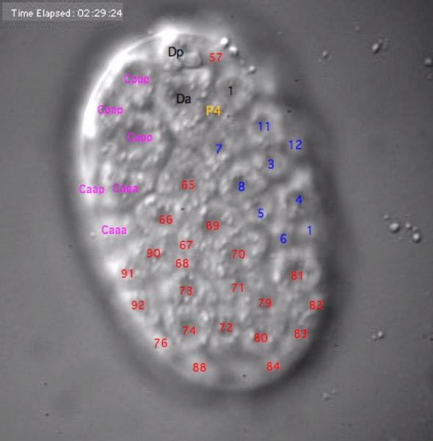


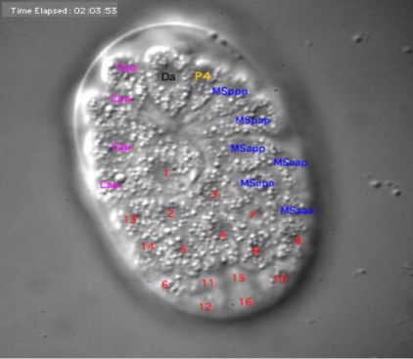
COURTESY: White Lab and Sharon (Fong-Mei) Lu, University of Wisconsin (flu2@wisc.edu).

Slide 22
The first four cells in the AB lineage:
Placement: 1) posterior left anterior, 2) posterior left posterior, 3) anterior left posterior, 4) anterior left anterior.
Original founder cell is no longer there.
* three axes of embryogenesis: anterior- posterior, left-right, dorsal- ventral.
C. elegans (unlike Mammalian embryos) have a specified pattern of embryogenesis.
* recall that cell fate is deterministic and environmentally-invariant.

Slide 23
Differentiation Trees
Seeing the trees through the forest of an epigenetic landscape. But why do we need to use differentiation trees when we already have a lineage tree?

Slide 24
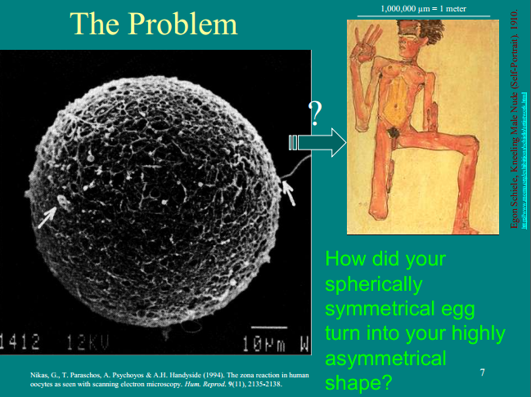

Slide 25
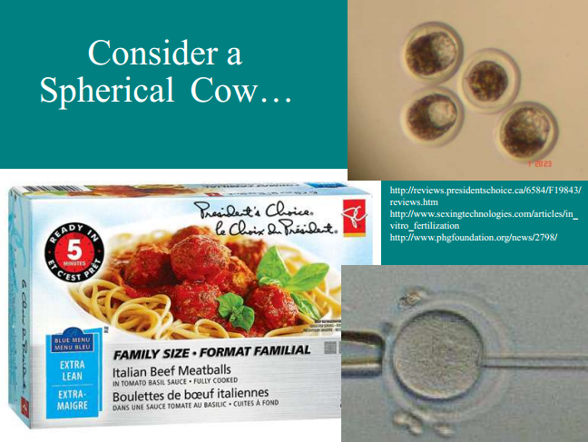

Slide 26
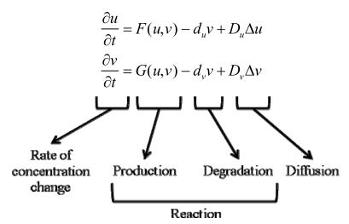
Turing A.M. The chemical basis of morphogenesis. Philosophical Transactions of the Royal Society of London, B237, 37-72 (1952).
Reaction-diffusion morphogenesis: a symmetry-breaking model?
Coupled differential equations produces spatial (gradient) and temporal (pulse) information

Slide 27
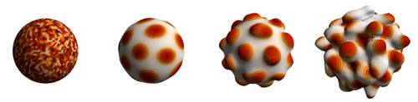
Turing A.M. The chemical basis of morphogenesis. Philosophical Transactions of the Royal Society of London, B237, 37-72 (1952).
Reaction-diffusion morphogenesis: a symmetry-breaking model?
Coupled differential equations produces spatial (gradient) and temporal (pulse) information
R-D morphogenesis (uniform) in fictitious organism
Ballus toadus
Image courtesy: http://mosaic.mpi-cbg.de/?q=research/gallery

Slide 28
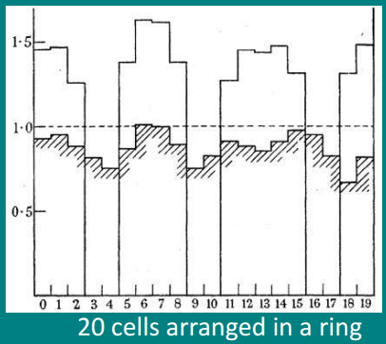
Turing A.M. The chemical basis of morphogenesis. Philosophical Transactions of the Royal Society of London, B237, 37-72 (1952).
Reaction-diffusion morphogenesis: a symmetry-breaking model?
An unstable equilibrium leads to initial random concentration of a morphogen (e.g. signaling molecule).
* leads to a morphogen wave at a specific concentration.
Physical evidence for instability phenomena in "morphogenesis“:
* Clark Maxwell (Stability of Motion of Saturn's Rings).
* Lord Rayleigh (viscous liquid under capillary force).

Slide 29
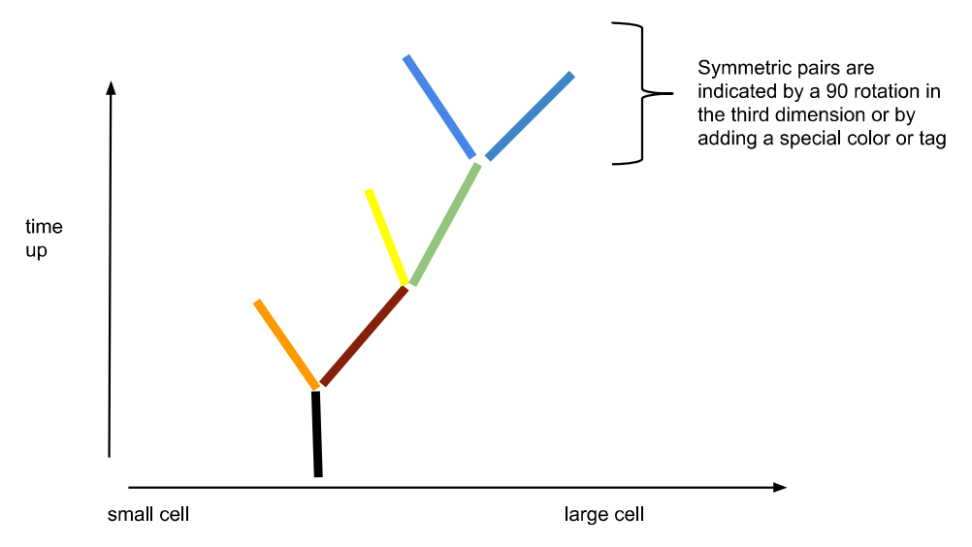
Organize cells from small to large:
* cell divisions (lineage branching) over time.
symmetry = 90 degree rotation in the third dimension (dorsal-ventral).
Two technical problems (developmental and computational):
* how do we represent multivariate attributes of branching lineages?
* How do we integrate a multitude of datatypes ?
D-V symmetrical
division
L-R division

Slide 30
RDF Framework
Informatics problem: How to build a data structure from semantic data?
* cells would have semantic tags which act as metadata.
* tags organized into a data structure that can be mapped to a tree structure.
* use the resource description frame (RDF) framework, based on XML.

Slide 31
RDF Framework
Informatics problem: How to build a data structure from semantic data?
* cells would have semantic tags which act as metadata.
* tags organized into a data structure that can be mapped to a tree structure.
* use the resource description frame (RDF) framework, based on XML.
Proposed solution: n-Quad data structure (extensible to new data types and sets of relationships).
* standard 3-tuples of information + context. For example:
* spatial 3-tuple (x,y,z): describes the location of a particular C. elegans cell in space.
* temporal 3-tuple: cell size (i), division event number (t), and the spatial angle of differentiation (θ).

Slide 32
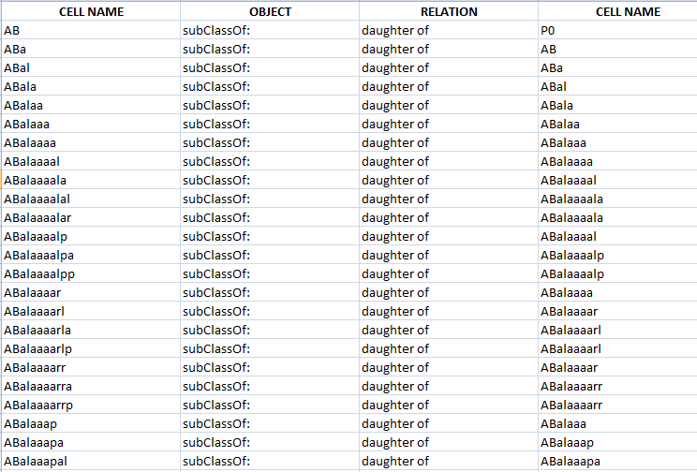
Metadata as a Means to Relate Objects
How to relate objects in the embryo, two at a time.

Slide 33
Metadata as a Means to Relate Objects
Relation field
(‘daughter of’ is a descendent node in data structure)
How to relate objects in the embryo, two at a time.
Object field
(‘subClassOf:’ is a datatype, specifies the kind of cell)

Slide 34
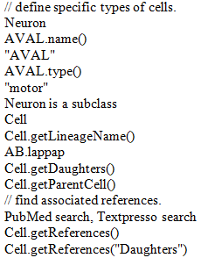
Defining objects:
* in this example (pseudo-code), we take a neuron from the OpenWorm project.
* neuron is a subclass of “cell”, and its cell identity (lineage) is “AB.lappap”.
* there is one type of “Neuron” for this instance, defined as “motor”.

Slide 35
Defining objects:
* in this example (pseudo-code), we take a neuron from the OpenWorm project.
* neuron is a subclass of “cell”, and its cell identity (lineage) is “AB.lappap”.
* there is one type of “Neuron” for this instance, defined as “motor”.
What objects can be associated with:
* we can associate this particular cell with other objects (parents, daughters) and metadata (PubMed, Textpresso).

Slide 36
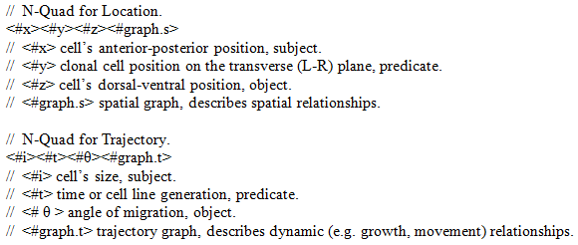
Pseudo-code showing the relational attributes of a differentiation tree:

Slide 37
Pseudo-code showing the relational attributes of a differentiation tree:
How to Visualize Graph:
* place each cell within a radial topology using semi-structured data.
* visualize using Unified Data Access (UDA) Layer protocol (PyMol).
* NetworkX proposed to integrate RDF and UDA.

Slide 38
Future Vision (the 25,000m view)
What can be done with DevoWorm? And why do it, anyways?
* incorporate developmental principles into the scheme of OpenWorm emulation.
* extensible platform serves as a basis for future simulation.
What features could be added in the future?
* genetic complexity (e.g. evolutionary developmental algorithms, detailed next-gen sequencing data).
* experimental prediction engine (e.g. what happens when a specific manipulation is performed?)
* biological diversity (e.g. emulation of males and hermaphrodites).

Slide 39
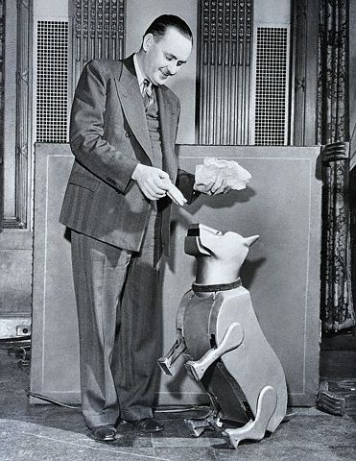
Sparko the Robotic Dog, Cybernetic Zoo
COURTESY: http://cyberneticzoo.com/tag/mechanical-animal/
Nice body, but how did it get there?

Slide 40
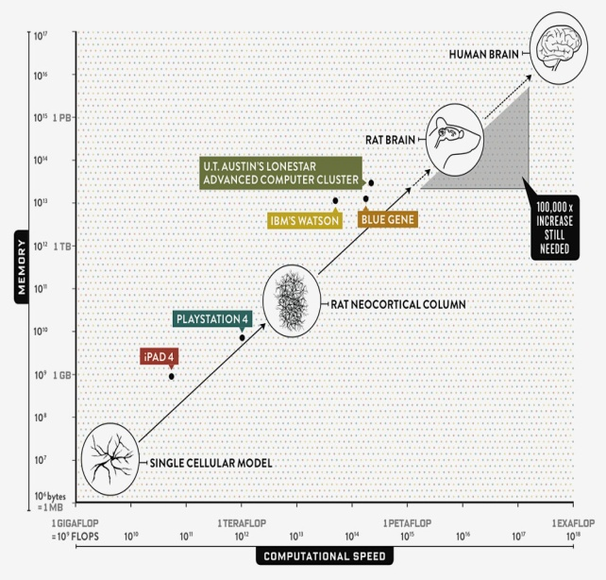
Nice goal, but how do you get there?
Throw enough supercomputing at a wall,
get a human brain?
COURTESY: http://www.wired.com/2013/05/neurologist-markam-human-brain/all/

Slide 41
Missing components to traditional whole-organism emulation:
DevoWorm can address some of these issues.
* what does “not biological enough” mean?
* developmental processes, generativity, stochasticity.
* organizing principles are not hard rules (or constraints).

